Slide 1
Presentation templates
Directorate 7 – Strategy and Communication
Corporate Design
in TU Dresden Corporate Design // as of May 2022
Corporate design rules - Guidelines for using the template and ensuring accessibility

Slide 2
Contents of the sample slide deck
Elements of TU Dresden’s Corporate Design
Logo
Font
Colors
Grid
Save template file
Accessibility
Second logos - layout options on title and content slides
Notes on working with the presentation template
Sample pages with TU Dresden content
TU Dresden
Diagrams
Infographics
DRESDEN-concept

Slide 3
Elements of Corporate Design

Slide 4



Logo How to use and place it
TUD's logo consists of a symbol and text.
It always appears as a whole and must not be cropped, translated or modified in any way.
The logo may be used in the following colors:
Blue (HKS 41) TUD primary corporate color
White (on blue, black or dark gray)
Black (on white or gray)
Gray (on white or gray)
In all 3 colors mentioned above also on photos

Slide 5
Font Corporate font Open Sans
Open Sans has been TU Dresden’s corporate typeface since January 2018. Open Sans was developed by typeface designer 🔗 Steve Matteson as a typeface that could be used for various media, including printed material, websites and mobile interfaces. It was published under the Apache License Version 2.0. The font is available in various font libraries on the internet and in TUD’s online internal area for free 🔗 download. The Open Sans font is embedded directly in this presentation template.
Font styles
Open Sans Light
Open Sans Light Italic
Open Sans Regular
Open Sans Regular Italic
Open Sans Semi-Bold
Open Sans Semi-Bold Italic
Open Sans Bold
Open Sans Bold Italic
Open Sans Extra-Bold
Open Sans Extra-Bold Italic

Slide 6
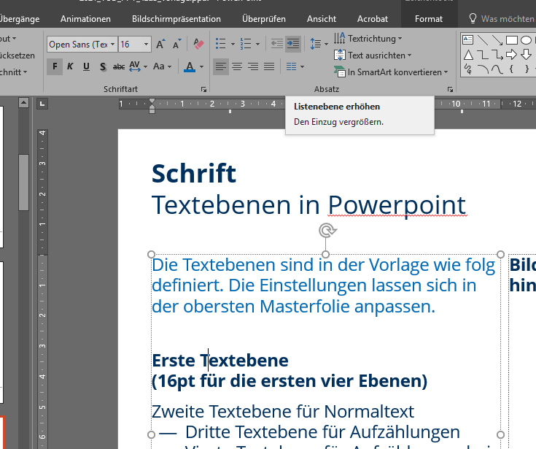
Font Use the list levels in PowerPoint
In the template, the text levels are defined as follows. You can customize the settings for the different 🔗 list levels in the first master slide.
First text level (16 pt for the first four levels)
Second text level for normal text
Third text level for enumerations
Fourth text level for enumerations if there is a lot of text
Fifth level (14 pt for all subsequent levels)
Sixth level for normal text
Seventh level for enumerations
Eighth level for enumerations
Ninth level for enumerations

Slide 7

Colors Basic colors and versions
The primary corporate color of TU Dresden is dark blue, hue HKS 41.
In addition, several secondary colors have been defined.
The colors can be used with different levels of opacity.
The colors are embedded directly in this presentation template.
You can store color palettes for Office in your system using the following file path.
C:\Users\..................\AppData\Roaming\Microsoft\Templates\Document Themes\Theme Colors
Name rgb hex
HKS 41 0 / 48 / 94 #00305d
HKS 44 0 / 106 / 179 #006ab2
Cyan 0 / 158 / 224 #009de0
HKS 92 114 / 120 / 121 #717778
HKS 33 147 / 16 / 126 #93107d
HKS 36 84 / 55 / 138 #54368a
HKS 65 106 / 176 / 35 #69af22
HKS 57 0 / 125 / 64 #007d3f
HKS 07 238 / 127 / 0 #ee7f00

Slide 8

Colors Allocated colors for the Schools and the Study Information System
 |  |  | Designation | rgb | Hex
 |  |  | MN light | 101 / 179 / 46 | #65b32e
 |  |  | MN dark | 0 / 137 / 58 | #00893a
 |  |  | BuU light | 0 / 172 / 169 | #00aca9
 |  |  | BuU dark | 0 / 131 / 141 | #00838d
 |  |  | ING light | 0 / 161 / 217 | #00a1d9
 |  |  | ING dark | 0 / 119 / 174 | #0077ae
 |  |  | GSW light | 224 / 49 / 138 | #e0318a
 |  |  | GSW dark | 206 / 0 / 117 | #c40075
 |  |  | MED light | 232 / 65 / 44 | #e8412c
 |  |  | MED dark | 205 / 23 / 25 | #cd1619
 |  |  | LEH light | 239 / 125 / 0 | #ef7d00
 |  |  | LEH dark | 201 / 75 / 23 | #C94B17
TUD’s five Schools are allocated the following colors.
In the Study Information System (SINS), equivalent colors apply for the SINS areas
+ additional orange for the SINS area teacher training.

Slide 9
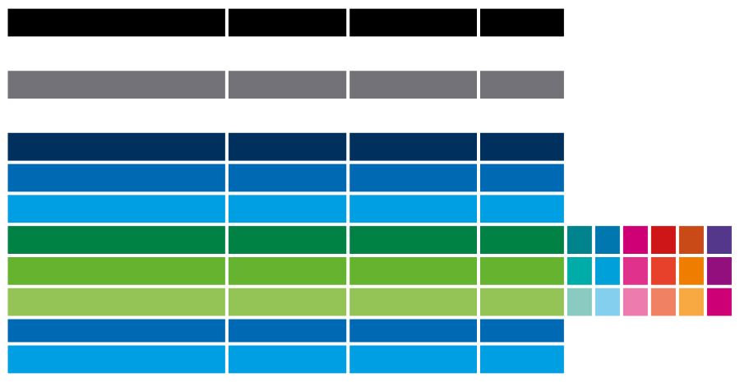
Colors Color palettes in Office
Office Color series | Designation | rgb | Hex
Text/Background -dark - 1 | Black | 0 / 0 / 0 | #000000
Text/Background -light - 1 | White | 255 / 255 / 255 | #FFFFFF
Text/Background -dark - 2 | Grey (HKS 92) | 114 / 119 / 119 | #727777
Text/Background -light - 2 | White | 255 / 255 / 255 | #FFFFFF
Accent 1 | Blue HKS 41 | 0 / 48 / 93 | #00305d
Accent 2 | Blue HKS 44 | 0 / 106 / 179 | #006ab2
Accent 3 | Cyan | 0 / 158 / 224 | #009de0
Accent 4 | Green dark | 0 / 137 / 58 | #00893a
Accent 5 | Green middle | 101 / 179 / 46 | #65b32e
Accent 6 | Green light
Hyperlink | Blue HKS 44 | 0 / 106 / 179 | #006ab2
Visited hyperlink | Cyan | 0 / 158 / 224 | #009de0
Within the color palettes for Office, (stored as .xml file) the accent color 4 - 6 changes

Slide 10
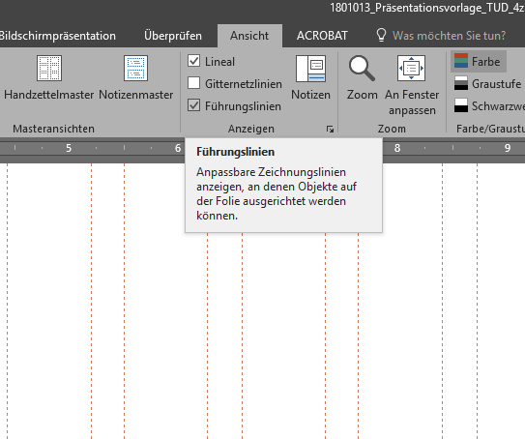
Grid for presentation templates
For all TUD publications, there is a standard corporate design layout grid. The grid defines the arrangement and position of the TUD logo.
In TUD presentations, the logo on all content slides is placed at the bottom left in the footer, next to the presenters' contact details.
In all other communication, the TUD logo is always positioned at the top left.
For this presentation template, the grid was deposited using alignment guides (Führungslinien). You can show them in the “View” menu. They are also useful when positioning image and text elements.
The line above the footer marks the area to be kept clear, but may be omitted as an element.
More information on this topic: 🔗 Microsoft Office / Guides

Slide 11
Accessibility Guidelines for creating accessible presentations

Slide 12
Accessible communication
The following aspects are essential to create an accessible document:
Use the content fields in the layout (p.14)
Use style sheets for text (p.15)
Avoid blank lines
Use the slide master if you need to customize many settings. Ensure good font size and color contrasts. Contrast calculator on 🔗 http://www.leserlich.info/ or installed: 🔗 Color contrast analyzer CCA)
Group images
Create image descriptions
If possible, insert diagrams and SmartArt as an image file including alternative text
Mind the settings for language and table of contents during PDF export. 🔗 You will find more information on this topic on the TUD service pages and on the 🔗 ELVIS website

Slide 13
Notes on working with the presentation template

Slide 14
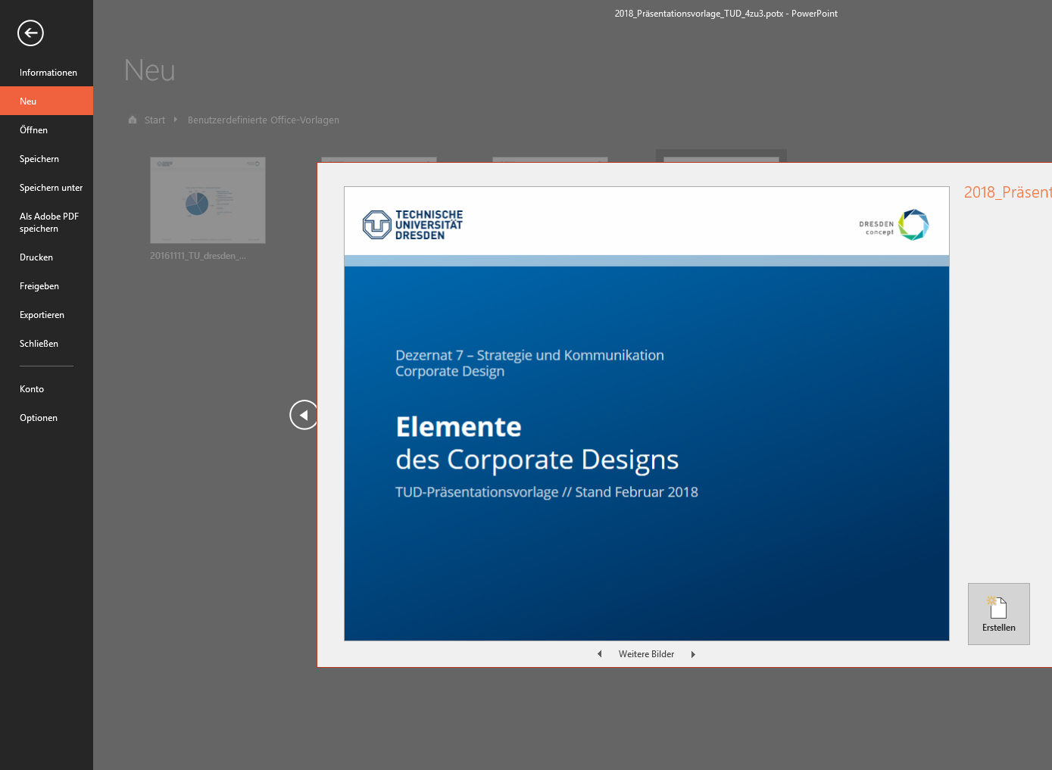
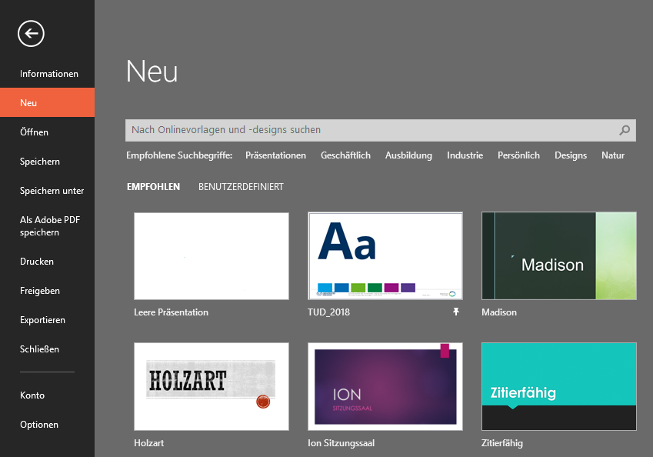
Create a new file
When creating a new PowerPoint presentation, you can select either a “custom template” or a “recommended design”.
This allows you to create additional formatting, e.g. for charts in Excel.
More information on this topic: 🔗 Microsoft Office / Designs

Slide 15
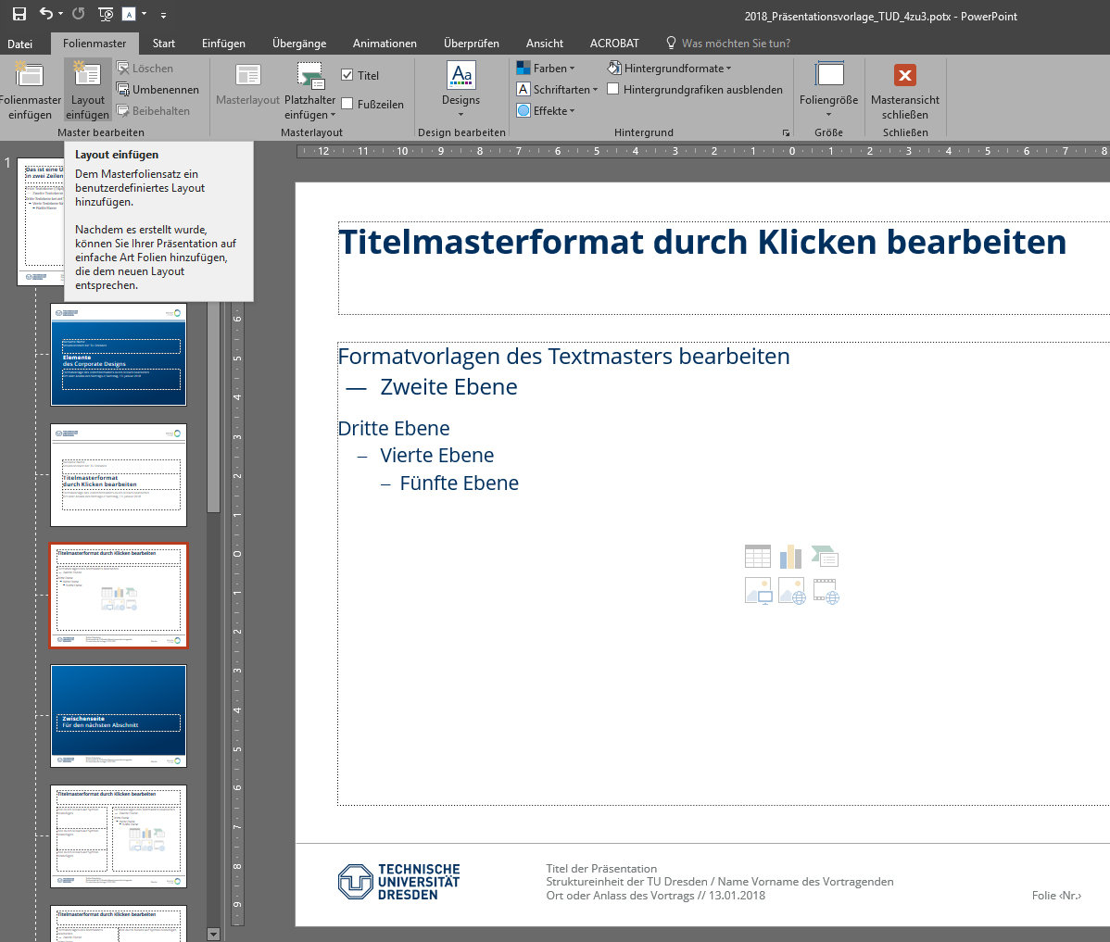
Working with the presentation template
For each new slide within a presentation, you should choose the appropriate layout (single-column, double-column, etc.).
Texts and images should be placed directly in the given fields.
For frequently repeated arrangements of image and text elements, it is worth creating additional layouts in the master slides.
This allows you to quickly combine different presentations into a single one and adjust the design to a uniform layout.

Slide 16
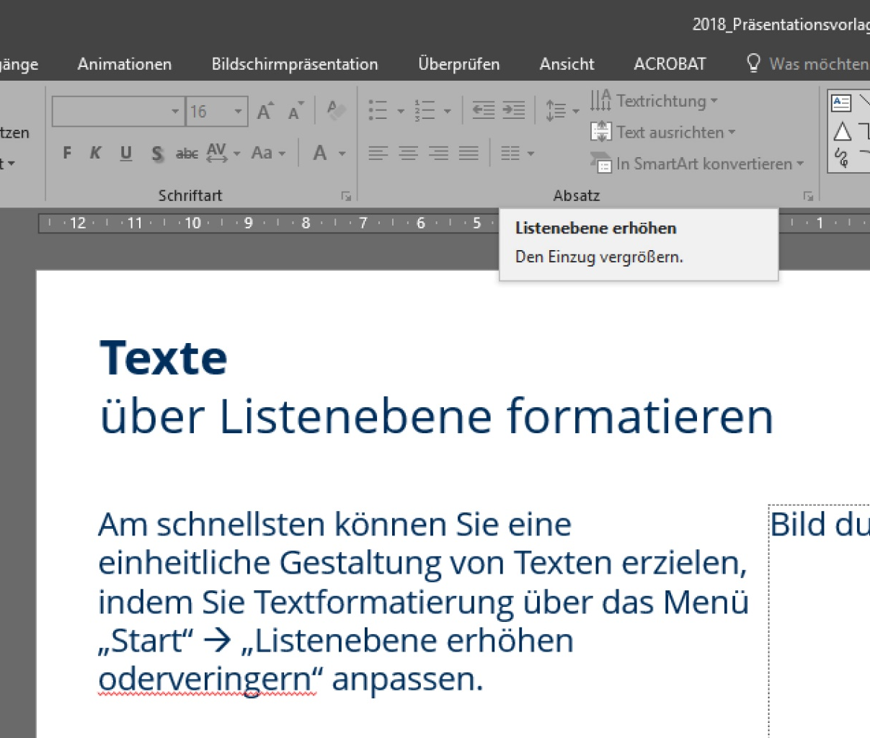
Formatting text using list levels
The quickest way to customize uniformly designed texts is by formatting them using the “Start” menu → “Increase or decrease list level”.
Equally, you can customize the text formats
font size
dashes
tabulators
text color, etc
in the slide master.
Minor changes and emphasis can be realized directly in the text by adapting font or paragraph.

Slide 17
Accessible communication
The following aspects are essential to create an accessible document:
use the content fields in the layout (p. 14)
use style sheets for text (p.15)
avoid blank lines
Use the slide master if you need to customize many settings.
Ensure good font size and color contrasts. Find detailed information on 🔗 http://www.leserlich.info/
group images
create image descriptions
Mind the settings for language and table of contents during PDF export. You will find 🔗 more information on this topic on the TUD service pages.

Slide 18

Placing secondary logos Placement options
Sample page
Edit by clicking
The secondary logo must not be larger than the TUD logo

Slide 19

Placement of the secondary logo for organizational units/projects with DRESDEN-concept
Secondary logo
In the footer
Left of the DRESDEN-concept logo
Height of secondary logo not exceeding the height of the TUD logo
Vertical alignment with the TUD logo
Position the secondary logo in the uppermost master slide and move the page number to the left, if necessary

Slide 20
Placement of the secondary logo for organizational units/projects without DRESDEN-concept
Secondary logo
In the footer
Second logo instead of DRESDEN-concept logo
Height of secondary logo not exceeding the height of the TUD logo
Vertical alignment with the TUD logo
Right-aligned horizontally along auxiliary line/grid
Replace the DDc logo with the secondary logo in the uppermost master slide

Slide 21
Title slide V1
Sample page
alternative examples below
Edit by clicking
Standard: white header and TUD logo in blue
Content area blue gradient and white font. Ensure good contrast and legibility!

Slide 22
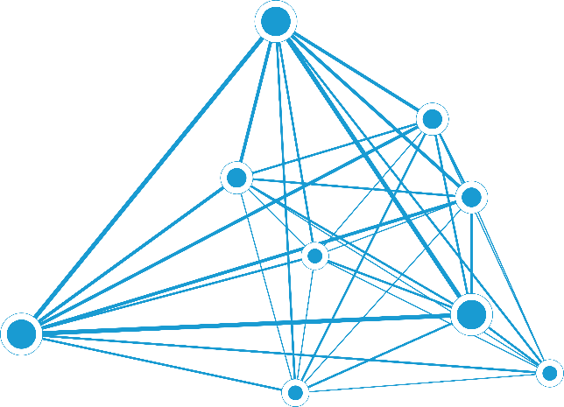
Title slide V2
Sample page
with a key visual in the background
Example design when using a key visual
Ensure a good contrast of the font to the background! (Example Chair of Privacy and Data Security) on blue background (full page option)

Slide 23
Title slide V3
Sample page
with a key visual in the background
Example design when using a key visual
Ensure a good contrast of the font to the background! (Example Chair of Privacy and Data Security) on blue gradient background (full page option)

Slide 24

Title slide V4
Sample page
with a key visual in the background
Slide layout white, TUD logo in blue and blue font.
Optional key visual can be added (see V2, V3)

Slide 25
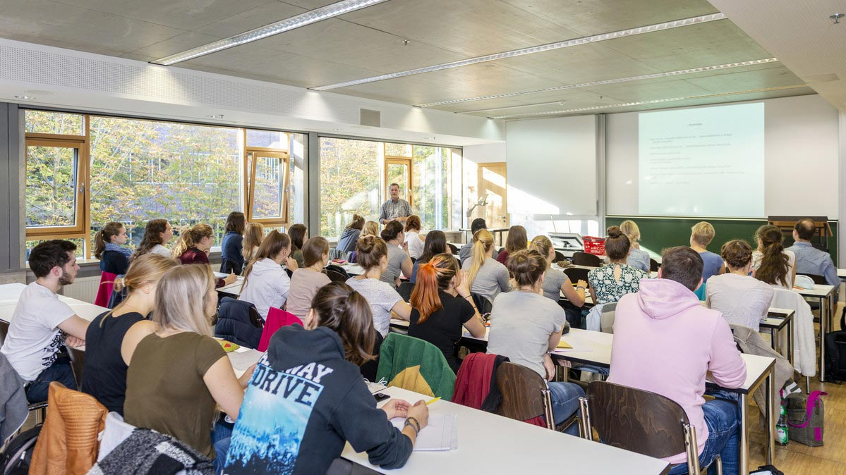
Title slide V5a
with full page image
TUD logo in front of a steady part of the image.
with full page image Ensure a good contrast of the font to the background! (if necessary, white partially transparent 10% or inverse dark blue background)

Slide 26
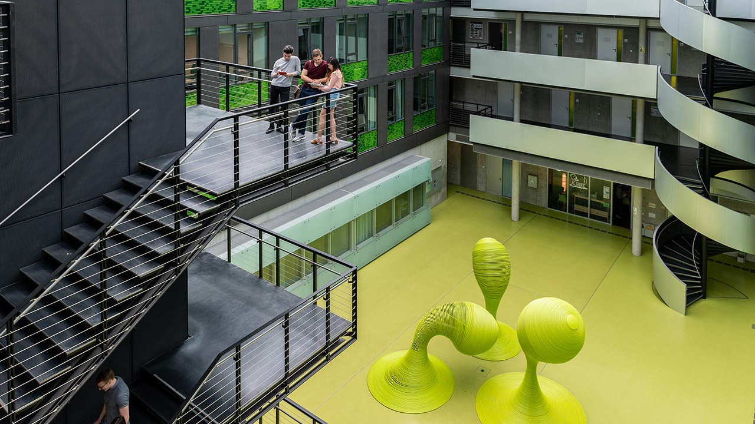
Title slide V5b
with full page image
with full page image
TUD logo in front of a part of the image that is not too busy.
Ensure a good contrast of the font to the background! (if necessary, white partially transparent 10% or inverse dark blue background) (sample image!)

Slide 27
Title slide V6
Sample page
with colored background
Sample design with colored content area and white header
Colored content area (different versions of the corporate design colors possible)

Slide 28

Title slide V7
Sample page
with a key visual in the background
Using a key visual (example: Diversity Management)
as an image in the background. Ensure a good contrast of the font to the background!

Slide 29

Title slide V7
Sample page
with a key visual in the background
Using a key visual (example: Occupational Health Services)
as an image in the background. Ensure a good contrast of the font to the background!

Slide 30
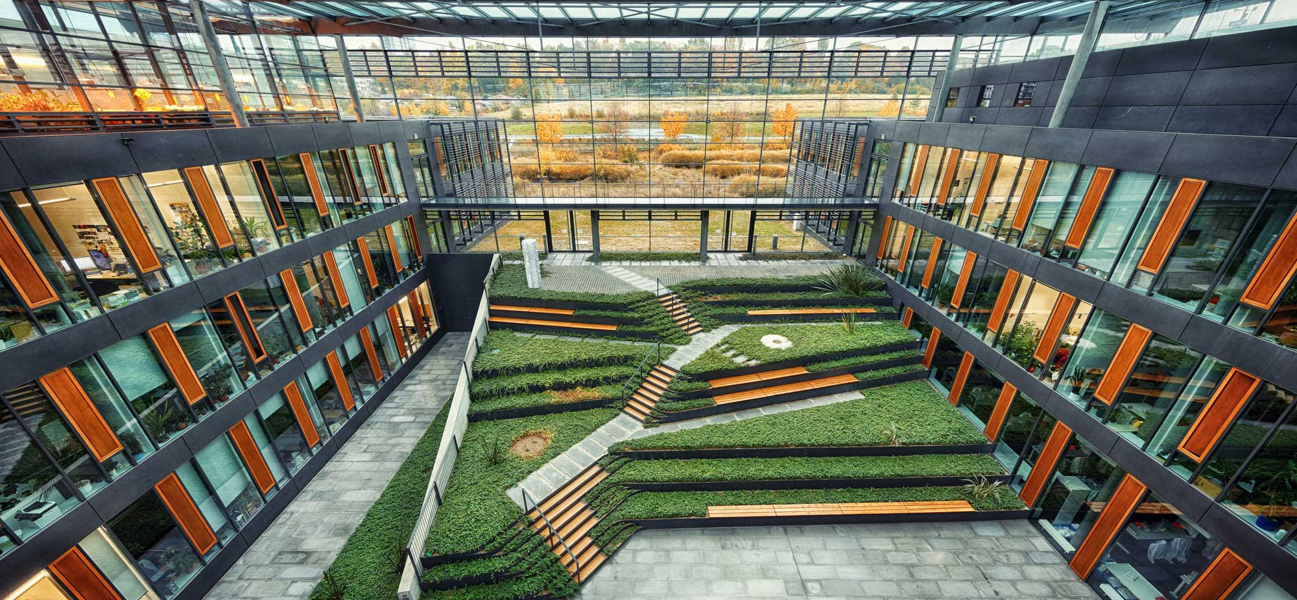
Title slide V8
Sample page
Ensure a good contrast of the logo/font to the background!
with image
Sample design; image can be used over the entire area
Ensure a good contrast of the logo/font to the background!

Slide 31
Save template file

Slide 32
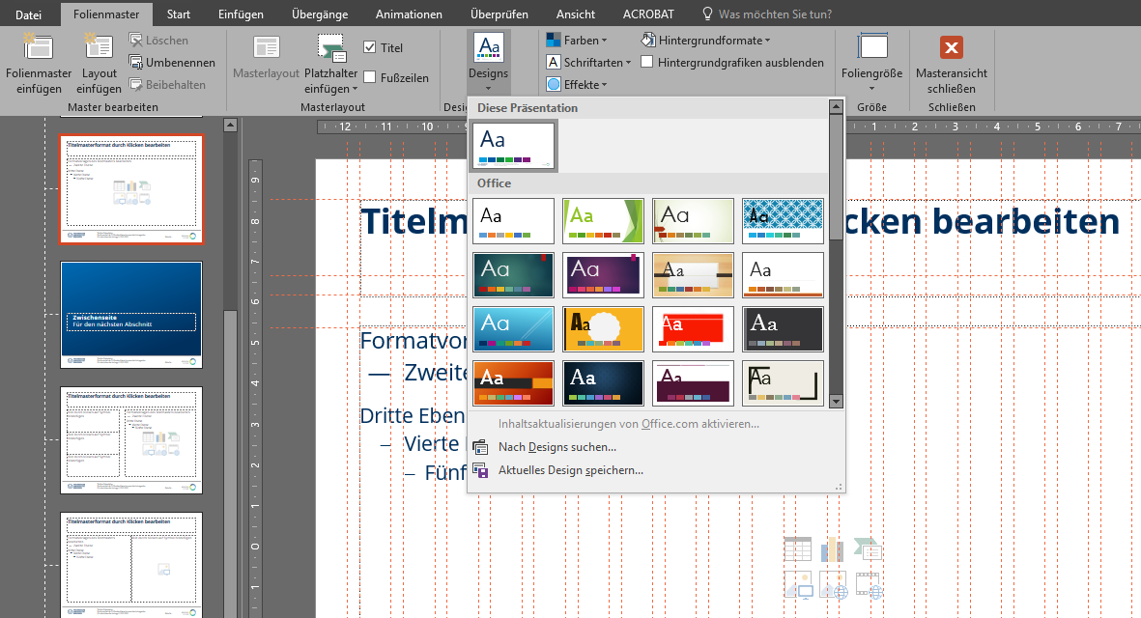
Save the design
In the “View” menu, you can open these master slides by double-clicking on “Slide Master” and save the current slide design in your own document templates.
This allows you to use the template each time you create a new presentation.
More information on this topic: → Microsoft Office / Designs

Slide 33
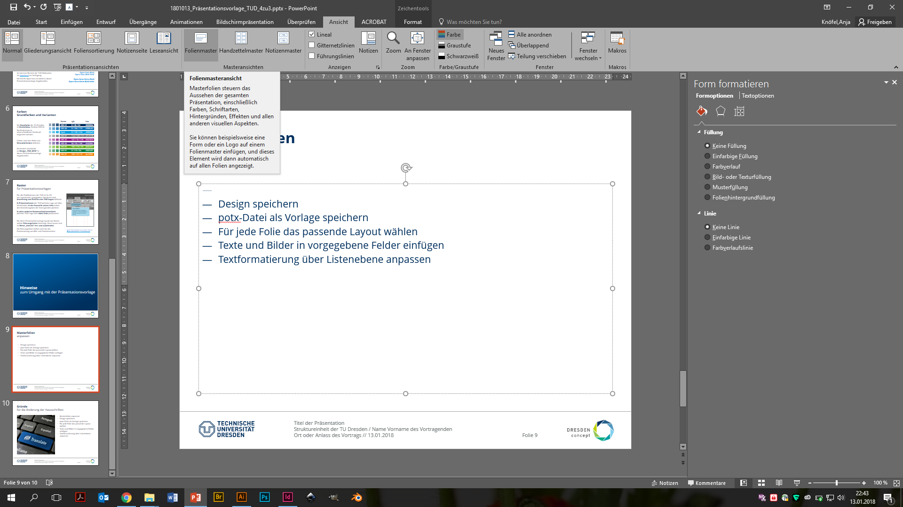
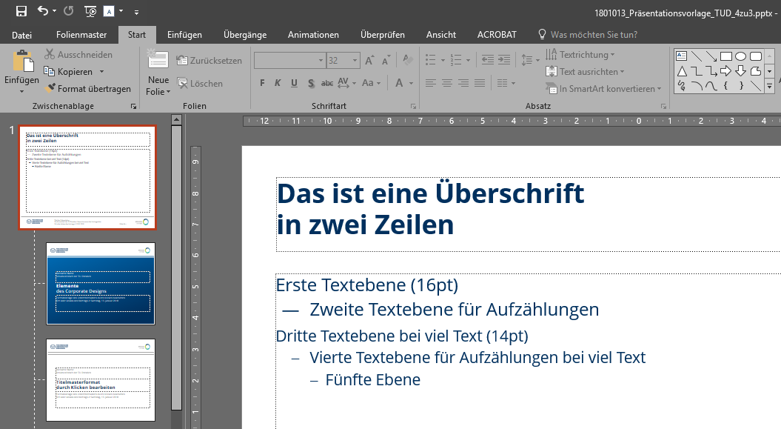
Customize the master slides
Using the master slides, you can efficiently manage the design of the entire presentation.
Within the master slides “Start” menu, you can customize the basic settings in the "slide master" as well as the related layout slides:
Contents of the footer
Slide background
Colors
Ssecondary logo and design elements
You may save another customized template this way.
Please note: When you open the master view, PPT does not show the slide master displayed larger at the very top (1). To show it, you need to scroll all the way up in the left vertical window.
More information on this topic: → Microsoft Office / Slide master
(1)

Slide 34
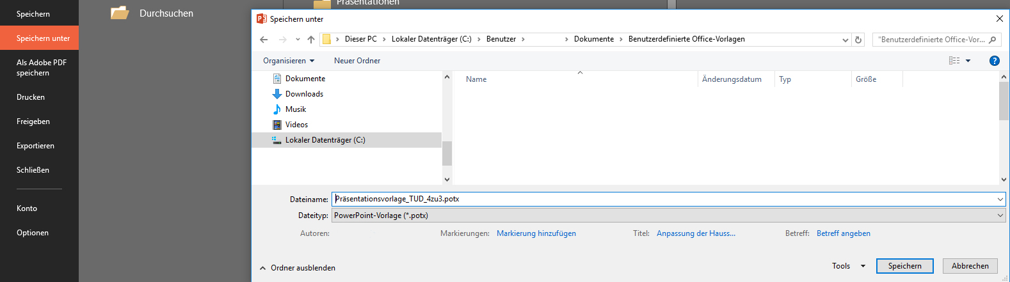
Save PowerPoint template as .potx file
You can save the customized presentation via the “File” → “Save as” menu as a PowerPoint template (.potx) on your own PC.
This also allows you to use the template each time you create a new presentation.
More information on this topic: → Microsoft Office / Slide master

Slide 35
More sample pages with TU Dresden content

Slide 36
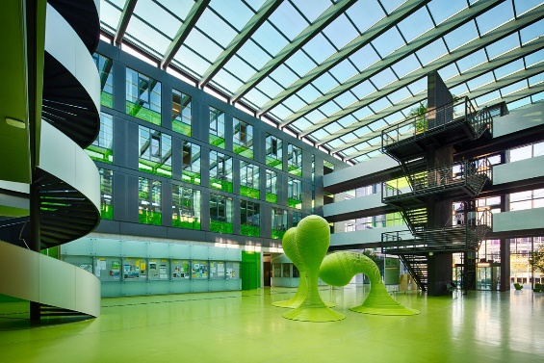



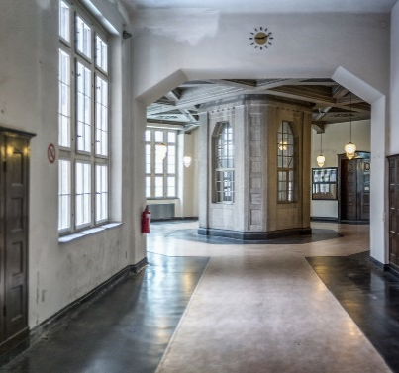

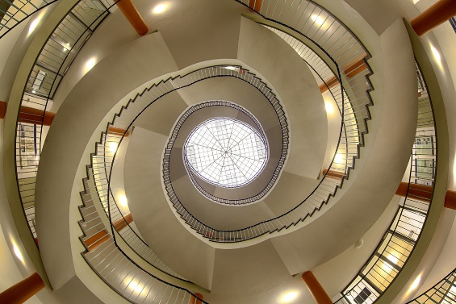
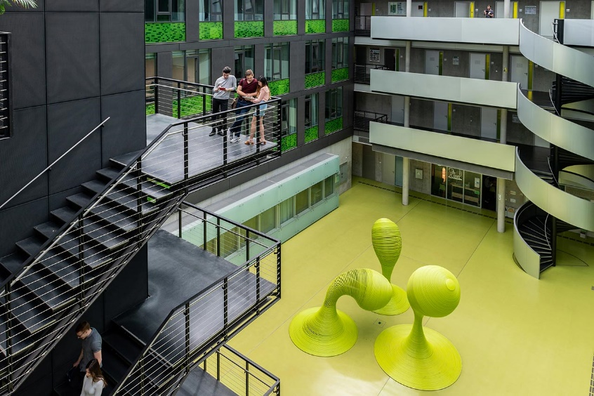
Example image potpourri (images from the TUD Image Pool)
Sample images - please delete for template fields underneath images

Slide 37
Technische Universität Dresden
Technische Universität Dresden (TU Dresden):
35,000 students
122 degree programs
18 faculties in 5 Schools: Civil and Environmental Engineering // Humanities and Social Sciences // Engineering Sciences // Science // Medicine
University of Excellence since 2012
Strong in research, dynamic, cosmopolitan, family-friendly
Since 1828

Slide 38
Diagrams monochromatic
Recommended design parameters:
Prefer two-dimensional diagrams (no 3D!)
Use monochromatic color versions, preferably in cyan Alternatively, you can also define a different contrasting color for the document
Text labels outside of the colored areas
Refrain from using shadows, gradients, etc.

Slide 39
Diagrams multicolored
Should you need multicolored diagrams because of your subject:
Use a consistent color scheme throughout the document
Customize color scheme to your own needs e.g.
DRESDEN-concept colors
SINS colors (Study Information System of TUD)
Colors of your organizational unit

Slide 40
Infografics using SmartArt
Recommended design parameters:
Reduce text
Prefer versions with larger areas
Use consistent colors throughout the document
Ensure good color contrasts and font sizes
Refrain from using shadows, gradients, etc.
Create complex graphics as a separate vector graphic (e.g. with Inkscape)
Background info
with 3 or 4 aspects
Mind the font size
Background info
With 3 or 4 aspects
Mind the font size
1 topic
2 topic
topic 3
Insert new topic
Emphasize important info
Background info
With 3 or 4 aspects
Mind the font size

Slide 41
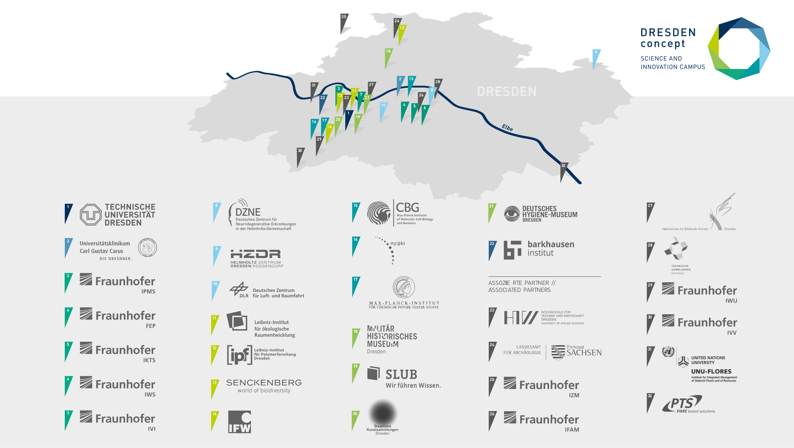
DRESDEN-concept network
Dresden Research and Education Synergies for the Development of Excellence and Novelty

Slide 42
DRESDEN-concept Excellence in science and culture
DRESDEN-concept is a network of TU Dresden with 32 partners in science and culture. All partners are research institutes and facilities in Dresden.
Synergies between TU Dresden and Dresden's non-university research institutions in research, teaching and infrastructure:
Joint identification and coordination of focal areas of research
Joint appointments / recruitment of leading researchers
Shared resources / one campus model
The core element is TU Dresden's application to become a University of Excellence.
What can you use the DRESDEN-concept network map in this presentation template for?
You are welcome to use the map to refer to the network in your presentations.
You can point out your own project partners in the network.

Slide 43




Sample design of a page with funding logos for customization according to the conditions in place.
This measure is partly financed by tax revenue on the basis of the budget adopted by the Saxon Parliament.

